Slide 1


Customer Propensity Model Analytics for marketing campaign design Product Launch
National City Bank
Notes:
`Hello and welcome to this presentation on Customer Propensity model which involves analytics and model development for marketing campaign desing

Slide 2

Project Objectives
Requirements
Create a Customer Propensity model for new product (Line of credit on used cars)
Identify top 100 prospects whom bankers should target for marketing campaign
Develop parsimonious models which
Offer Simplicity & interpretability
Generalize new data well
Avoid Over Engineering
Computationally Efficient
Insights on target profiles
Deployment recommendations to identify probability of marketing offer acceptance by prospects
National City Bank
Notes:
Objectives includes creation of a parsimonious model that identifies the top 100 prospects / customers of bank who should be targeted with campaign of a new product and then to provide insights on target profiles

Slide 3

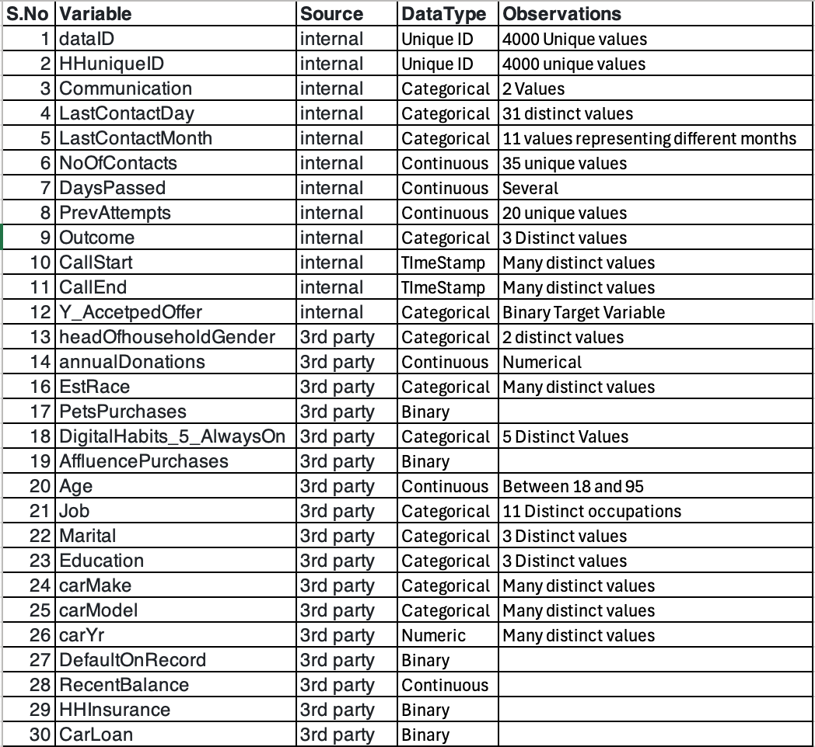
DataSet Preview
Data Files
Data Elements
Data load
Several datasets internal and external are loaded.
currentCustomerMktgResults
householdAxiomData
householdCreditData
householdVehicleData
prospectiveCustomers.
Data joins:
All datasets (except prospective customers) are joined together based on a unique household identifier HHuniqueID to form a consolidated fullDataSet for analysis to develop a streamlined model to predict line-of-credit acceptance with a focused set of predictors
National City Bank
Notes:
Data Set available for the research team includes several attributes from both internal and external sources. This includes customer marketing results, household data about credit, vehicles among other demographic info
Approach taken was to combine all data sets using common identifier and analyze the variables to distinguish continuous variables from categorical. table summarizes this info

Slide 4
Selection Rationale
Variables
Algorithms
Target Variable: Y_AcceptedOffer serves as the binary target variable, where "Accepted" is coded as 1 (success), and "DidNotAccept" as 0.
Initial Examination
Duplicate and high-cardinality variables were identified and removed to reduce complexity and prevent overfitting.
These include LastContactMonth, LastContactDay, carMake, carModel, EstRace, and Job.
Duration for each contact was computed based on CallStart and CallEnd.
Data Partitioning :
A random 90%-10% split was applied to create training set with more data and a Validation set.
Preprocessing with vtreat:
The vtreat package created a treatment plan to handle categorical outcomes and handling missing values.
Model Selection and Training
Since target variable is binary, following supervised classification models were used:
Logistic Regression
Classification Tree (Decision Tree)
Random Forest
National City Bank
Notes:
now in terms of some choices made, Target variable is offer acceptance which could be modeled as a binary variable
From input variable initial exam we can exclude some duplicates variables and categorical variables which have high cardinality and also derive some variables like duration from call data.
Data was first parititioned then preprocessed.
Finally given this is a binary classificaiton model ask, Log Reg, D tree and RF methods were chosen to model it.

Slide 5
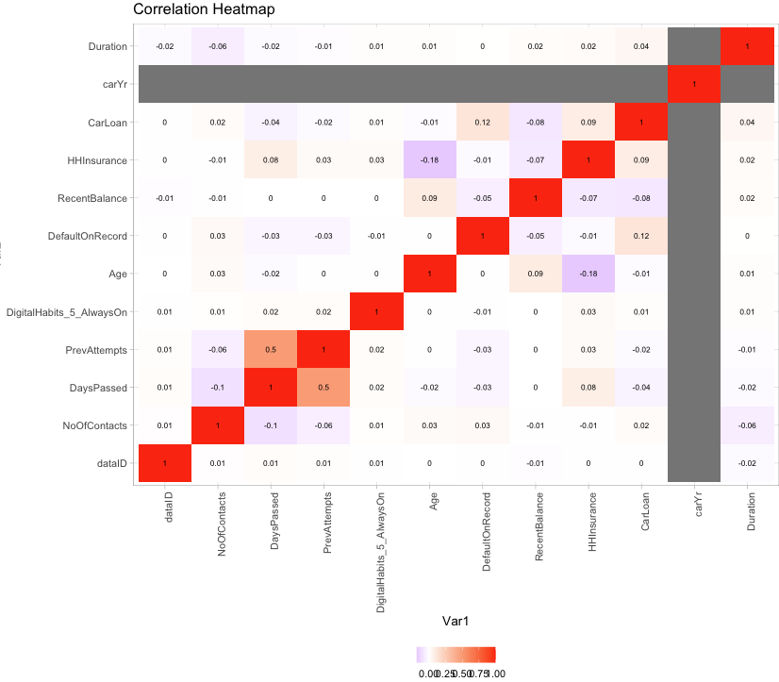
Collinearity Review
Correlation heatmap
A correlation heatmap is a good visual tool used to interpret the relationships among various variables in the dataset.
Apart from the obvious perfect self-correlations, most variables show very weak correlations (close to zero) below 0.5.
Overall, the dataset exhibits low multicollinearity among features, with only a few moderate correlations, supporting the pursuit of a parsimonious model without significant redundancy among input variables.
National City Bank
Notes:
One of the approaches to eliminate multicollinearity in the model is to review correlation matrix / heatmap, and the input variables left from previous stage show weak correleation thus ruling out multi collinearity between left input variables in this excercise

Slide 6



Logistic Regression 1 of 2
Model Development & Design Steps
Initial Regression:
A logistic regression model (logReg) was fit using all the input variables.
AIC (2732.4) and p-value below cutoff.
Backward Stepwise Selection:
To improve the model's parsimonious nature, backward stepwise selection (step() function) was applied to eliminate less significant predictors, resulting in a refined model (bestLogReg) with an AIC of 2711.2.
Final Model:
use only significant variables to form a new logistic regression model with a slightly higher AIC (3033.7),
indicates a slightly less optimal fit compared to the previous model but focuses on computational efficiency.
Thus, a more efficient and explainable logistic regression model was built, balancing simplicity and performance.
National City Bank
Notes:
For logistic regression steps performed were initial regression on which backwards stepwise selection process was applied to further optimize and chose a final model which was more parsimonious by the inclusion of only relevant variables without any signifiicant drop in accuracy.

Slide 7
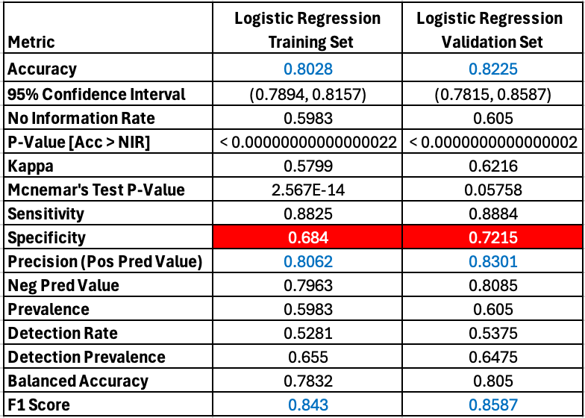
Logistic Regression 2 of 2
Results / KPI’s
Summary of Model Performance
Overall Performance: The model performs well on both the training and validation sets with strong accuracy, sensitivity, precision, and F1 scores. There is a slight improvement in generalization from the training set to the validation set, especially in terms of specificity, NPV, and F1 score.
Room for Improvement: While the model is doing well, increasing specificity (identifying more true negatives) and reducing false positives further could still be beneficial, as the minimizing false positives is critical for this use case .
National City Bank
Notes:
Results clearly show a good accuracy and a strong F1 score. However specificity could still be improved on this model since false positives could have significant impact o the objective, its worth keeping an eye on improving specificity

Slide 8
Classification Tree 1 of 2
Model Development & Design Steps
Complexity Parameter: A range of complexity parameter (cp) values were tried to keep model simple without sacrificing predictive power. The optimal cp of 0.005 was chosen based on the lowest Root Mean Square Error (RMSE)
Tree Pruning: Used min-split = 10 and min-bucket = 5. These parameters enforce minimum requirements for node splits and final node sizes
Cross-Validation :. Cross-validation within caret’s training process ensures that the chosen model generalizes well to unseen data, reducing the chance of overfitting.
This approach helps with a simple yet effective tree model by using cross-validation, optimal complexity parameter selection, and controlled splitting for robust predictive performance.
National City Bank
Notes:
moving on to next model which is classification tree, here we played with a few cp values to identify the least cp and then pruned the trees and finally performed cross validation to ensure good ability to generalize

Slide 9
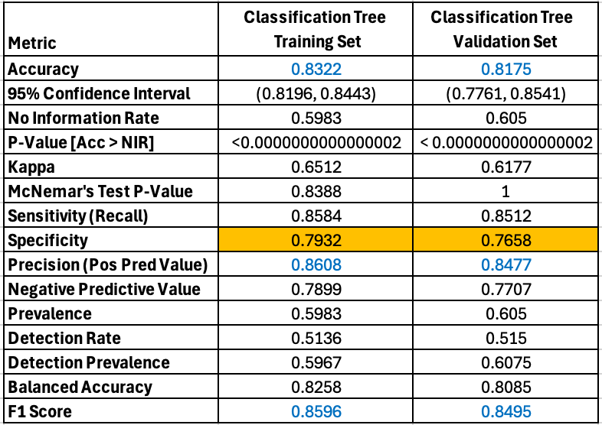
Classification Tree 2 of 2
Results / KPI’s
Summary of Model Performance
Overall Performance: Slight decrease in performance on the validation set, but the model still shows strong generalization and performs significantly better than random guessing. strong F1 scores, high accuracy, sensitivity, specificity and Kappa
Room for Improvement: The model already performs well, but there may be a potential for improvement by Fine-tuning the cutoff threshold to balance precision and recall.
National City Bank
Notes:
Results clearly show a good accuracy and a strong F1 score. However specificity could still be improved on this model by perhaps adjusting cutoff from 0.5 (default) used to other values

Slide 10
Random Forest 1 of 2
Model Development & Design Steps
Identifying Overfitting: The initial model, with 100 trees and an mtry of 10, yielded overly high accuracy, signaling overfitting. This prompted a need to simplify the model to enhance generalization.
Reducing Model Complexity: Through a series of iterations, adjusted the model to use only 50 trees and lowered mtry to 5, ensuring fewer features at each split. These changes made the model less dependent on specific data points, improving its robustness.
Evaluating Feature Importance: By examining and plotting the top 20 influential features, we identified the key variables driving predictions. This approach enabled us to simplify the model further by focusing on essential features, achieving interpretability and reducing overengineering.
These steps ensured a model that avoids overfitting while preserving predictive power and clarity. However, based on results seen the model is still overengineered to an extent given the drop in accuracy against validation set. Hence, we can conclude that there is still room for improvement based on parameter tuning.
National City Bank
Notes:
Random forest, typical problem was overfitting with various parameters, so i decided to reduce complexity without loosing accuracy with ntree= 50 and mtry =5 We also plotted the top 20 most influential variables on a graph.

Slide 11
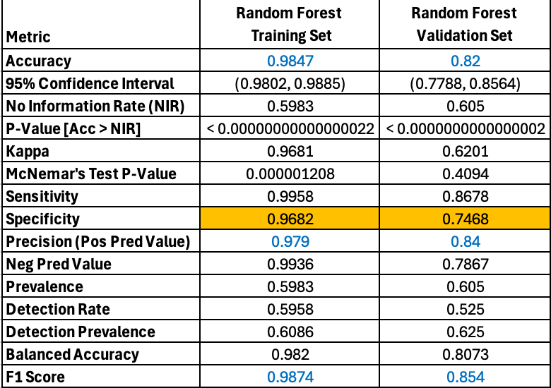
Random Forest 2 of 2
Results / KPI’s
Summary of Model Performance
Overall Performance: Noticeable drop in performance on the validation set, suggesting potential overfitting and thus the lack of generalization on new datasets
Room for Improvement: The validation set metrics indicate that while the model is still effective, there is room for improvement, especially in balancing sensitivity and specificity.
National City Bank
Notes:
While training set shows high levels of accuracy the model showed a noticeable drop in performance when it moved to validaiton set. thus indicating there was some overfitting and hence again there is opportunity for optimization although in an overall sense the model still shows above 80% accuracy on both data set which means it holds alright.

Slide 12


Target Profile
Identify top 100 Customers
Derive Insights
Combine Results :
Combine predictions from the training , validation (and prospects)
Calculate Ensemble Average:
Calculate the average of predicted probabilities from three models
Rank Customers by Probability:
Rank the customers probabilities based on the average probability in descending order.
Select Top 100 Customers:
FullResults is filtered to retain only the top 100 customers based on rank, creating a data frame of topCustomers100.
Identify Key Indicators:
The variables past_Outcome, RecentBalance, CarLoan, and Duration are noted to be strong indicators of likelihood for product acceptance as most of the top 100 customers share the same values for these variables.
This allows for an easier schematic to identify target demographic.
National City Bank
Notes:
given the shortcomings of each model an approach to combine results from all three and average the probabilities was used to identify the top 100 customers
In terms of insights Past Outcome being success,Recent Blance being above 100 , call duration being above 200 and No Carloan all shows strong likelihood of customer accepting the marketing offer

Slide 13
Deployment Recommendations
Best Model
How to Apply to Prospective Customers
Next Steps
As previously summarized, each model has some pros and cons, while all of them offer excellent accuracy and stability.
An Ensemble is a good ay to resolve the tie and get the characteristics from all models
Run all three models and the code to calculate the ensemble average to apply to prospectives.
Periodic execution of the ranking on ensemble average probability on a prospective customer data should help identify leads for campaigns
Review other demographic variables that could be added to the model to reduce the residual unexplained parts of the model.
Test & iterate further with larger data sets to improve specificity and balance with sensitivity.
National City Bank
Notes:
final thoughts then, Ensemble would be the best model as it covers the average from many voters
The ensemble method could be applied on prospective customers to identify new leads for marking campaigns
Laslty there is always room for improvement which could range from of addition of more relevant input data to iterative model tuning to stay relevant to evolving trends

Slide 14

Thank you
National City Bank
Notes:
thank you to all the audience for your time on this presentation

